Slide 1
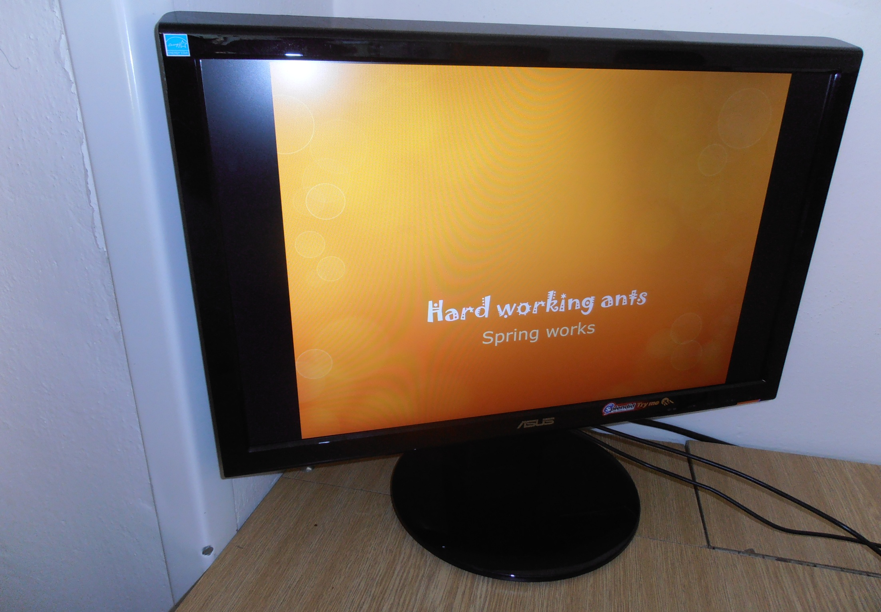
Pupils from the Czech Republic introduce

Slide 2
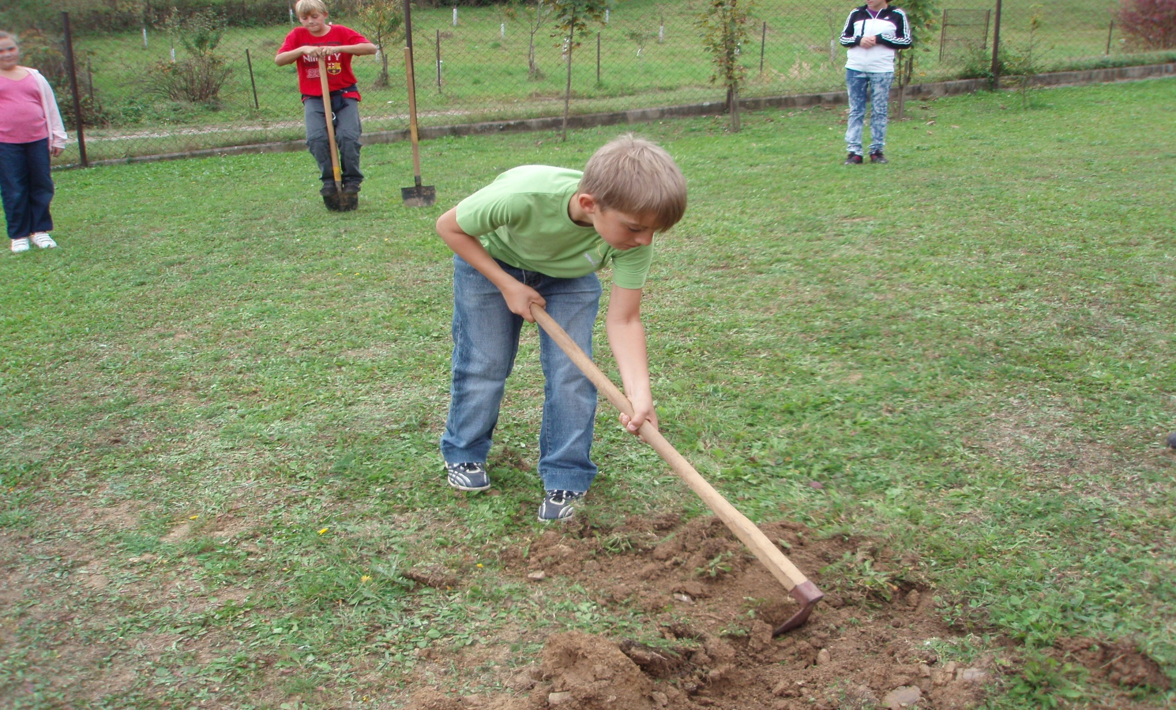
David tries to change our school garden

Slide 3
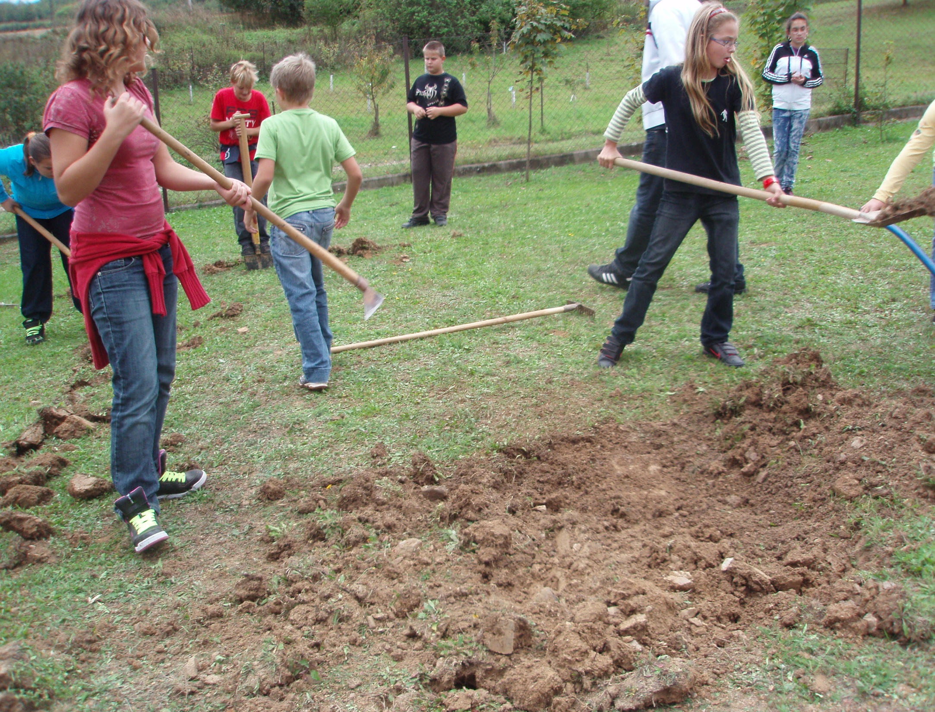
The others help him

Slide 4
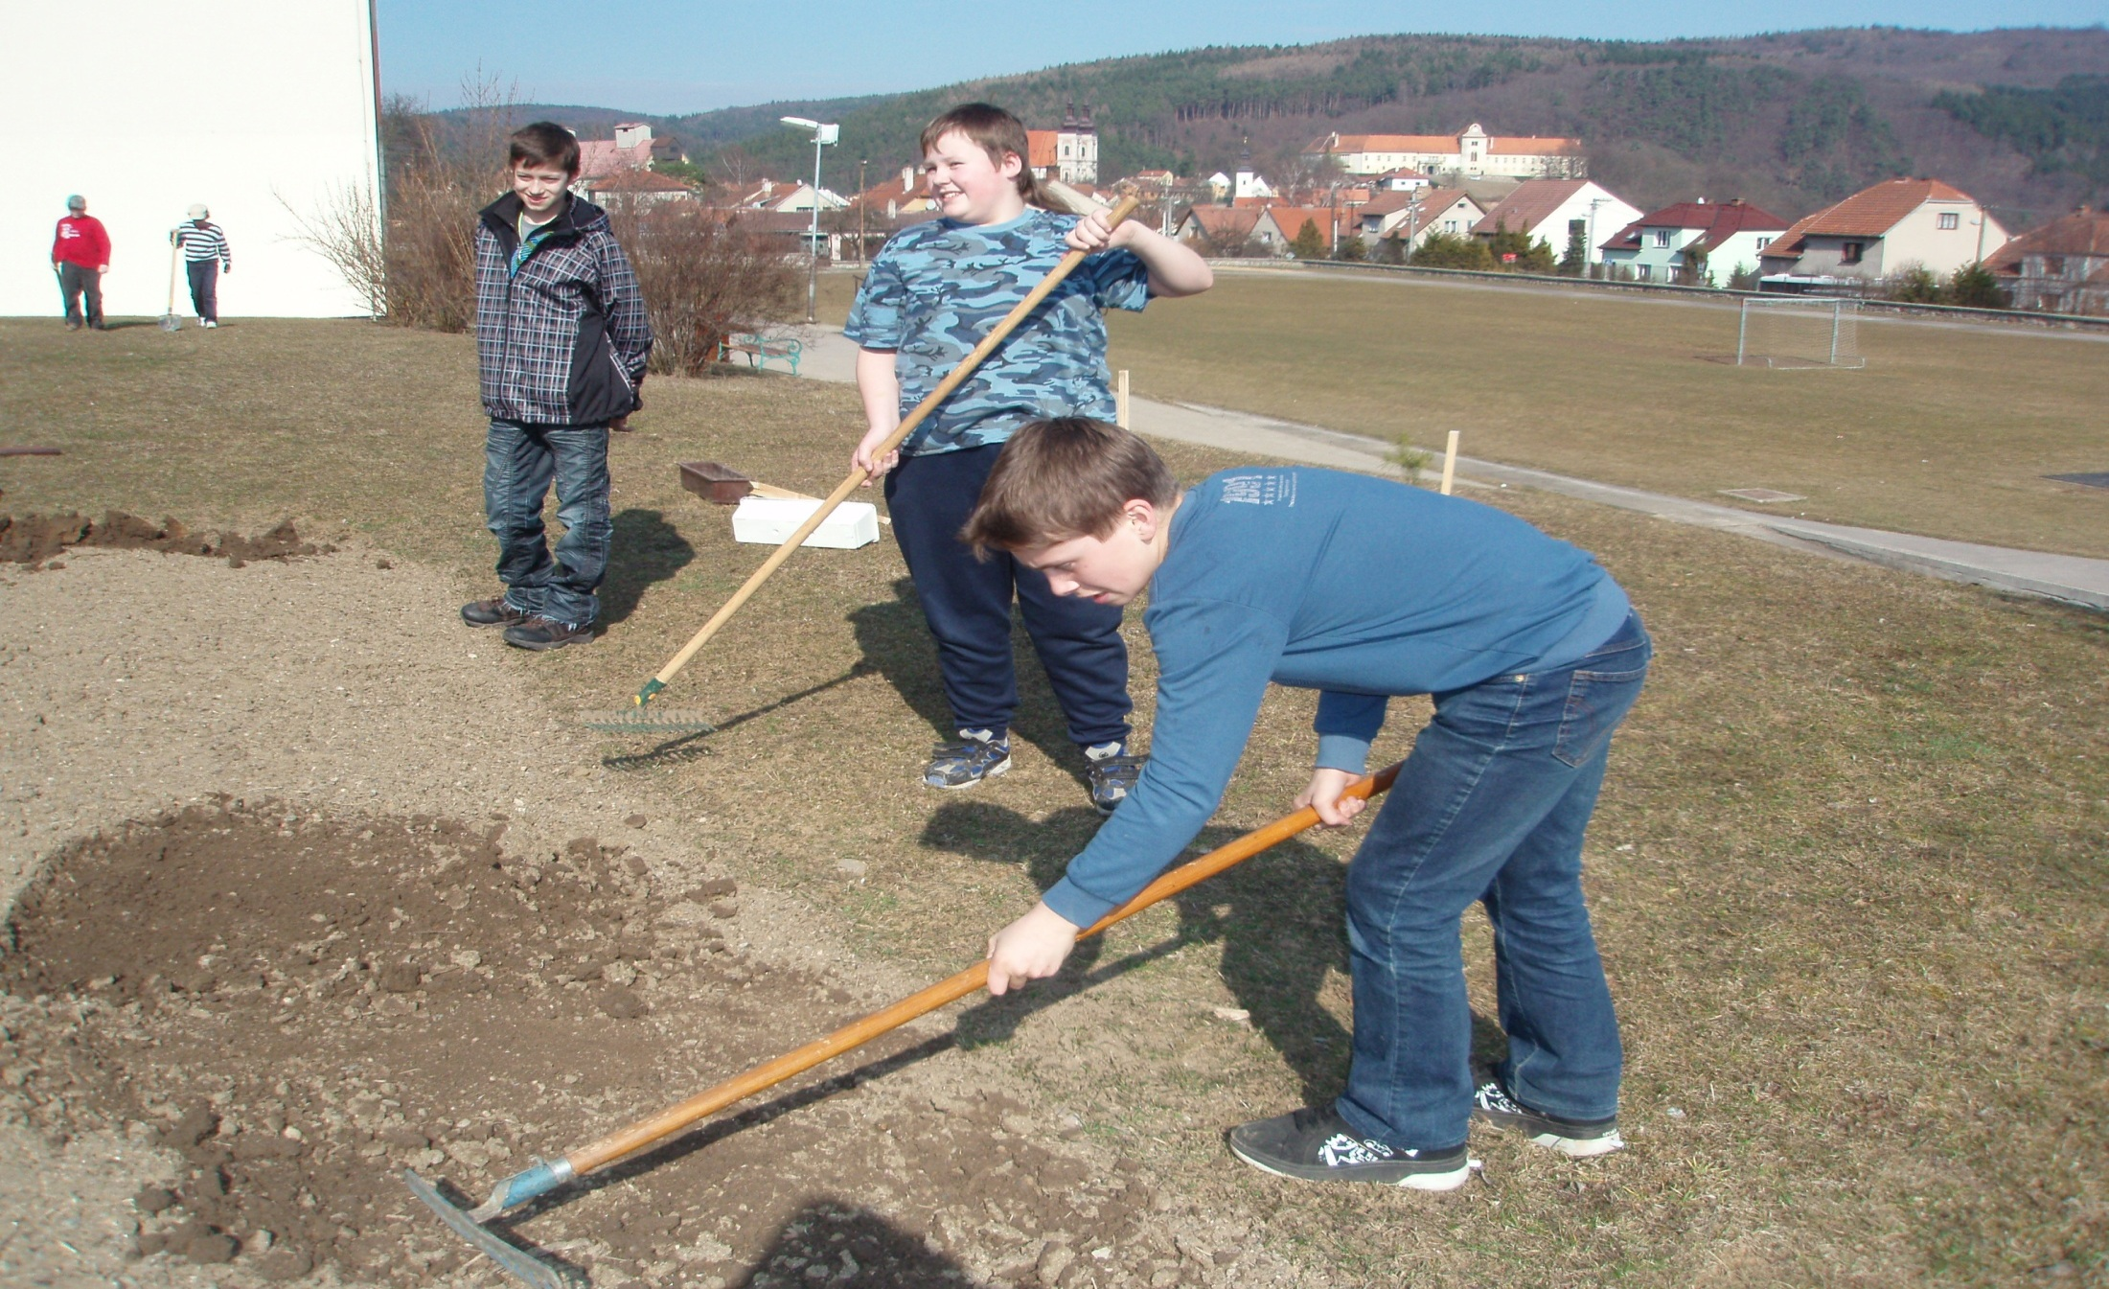
Matěj helps by watching

Slide 5
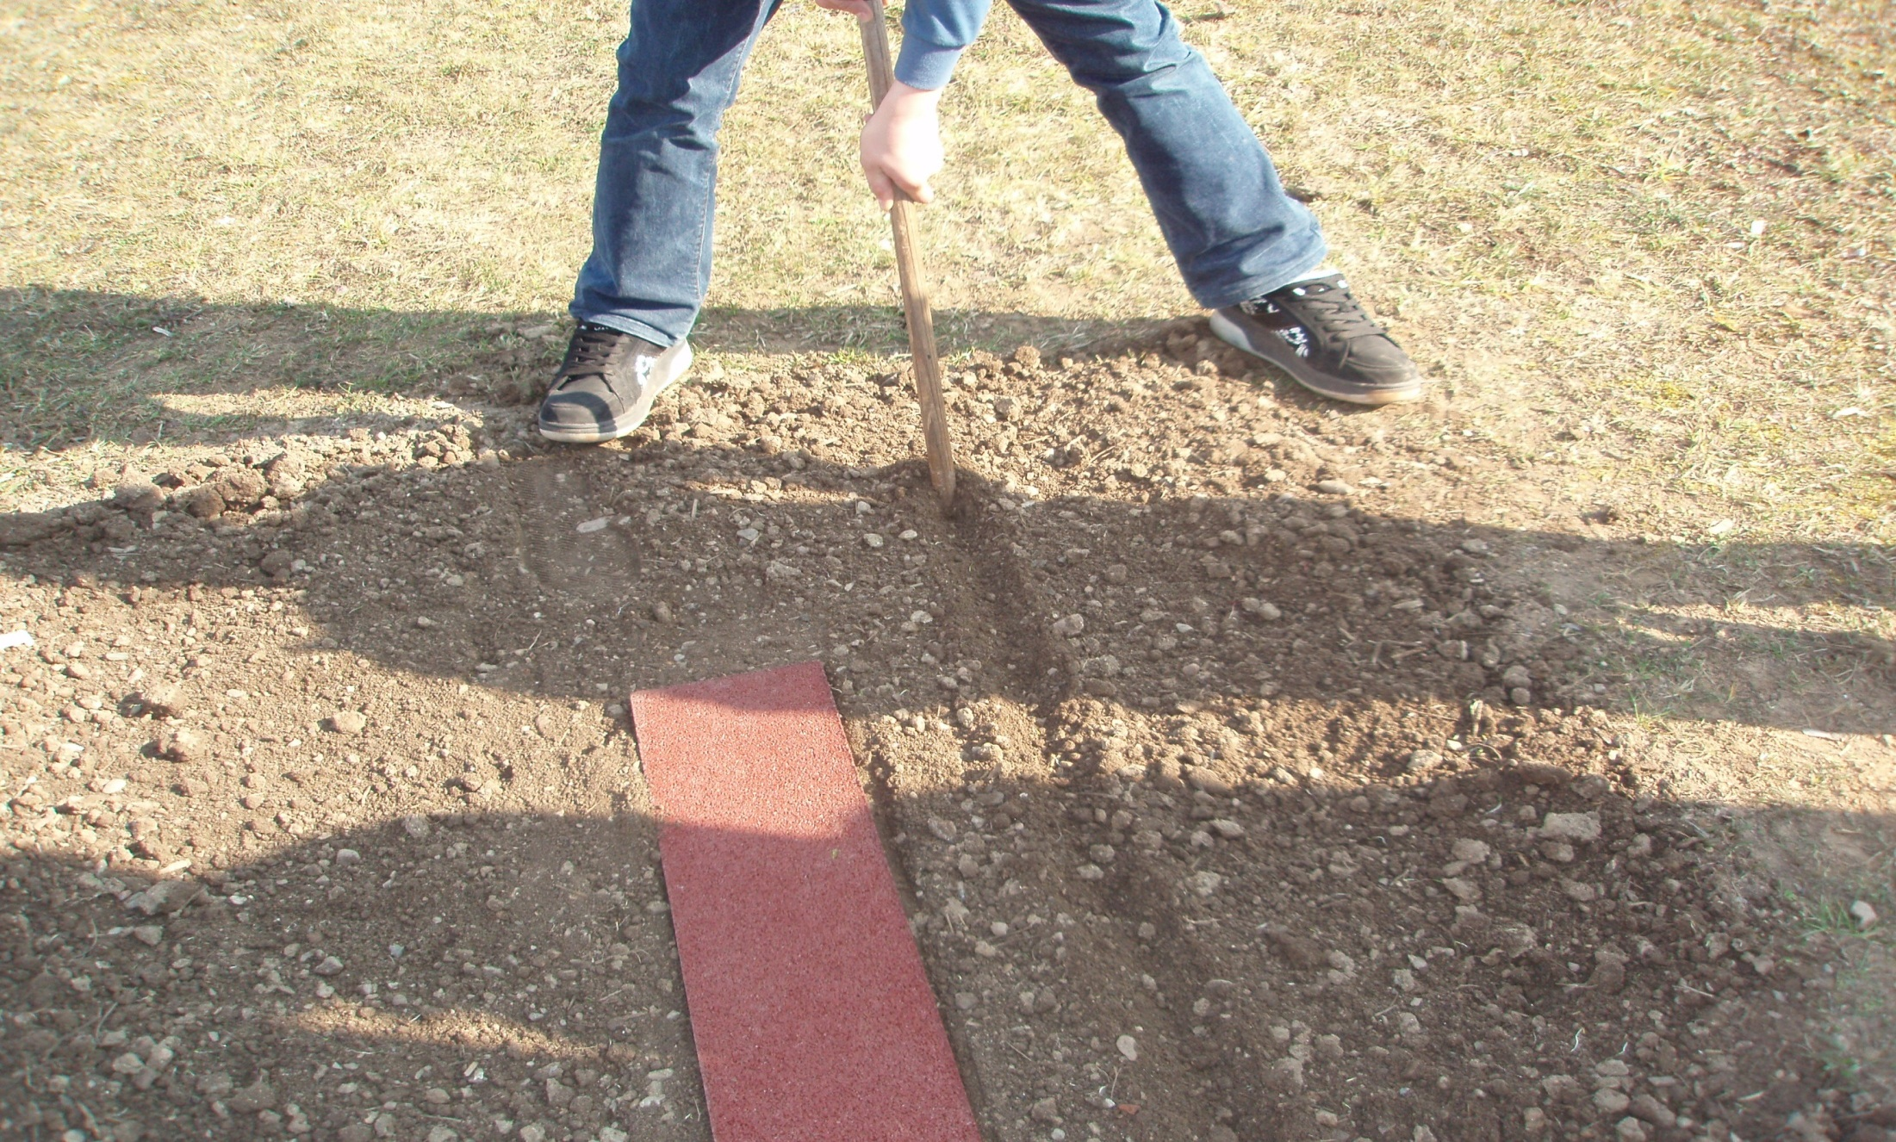
And without a ruler we can make the straight line

Slide 6
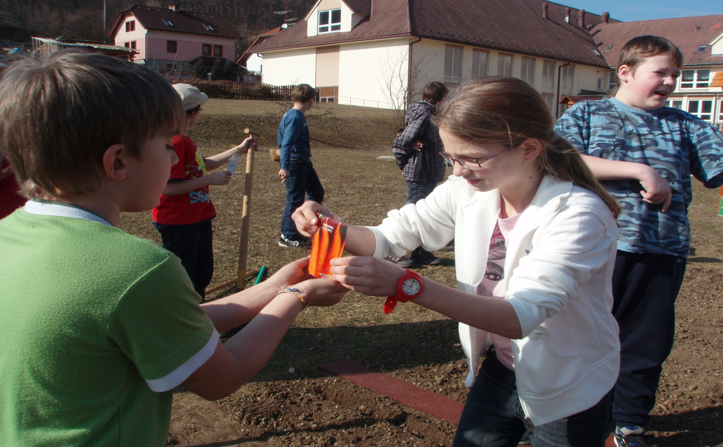
The both are very careful

Slide 7
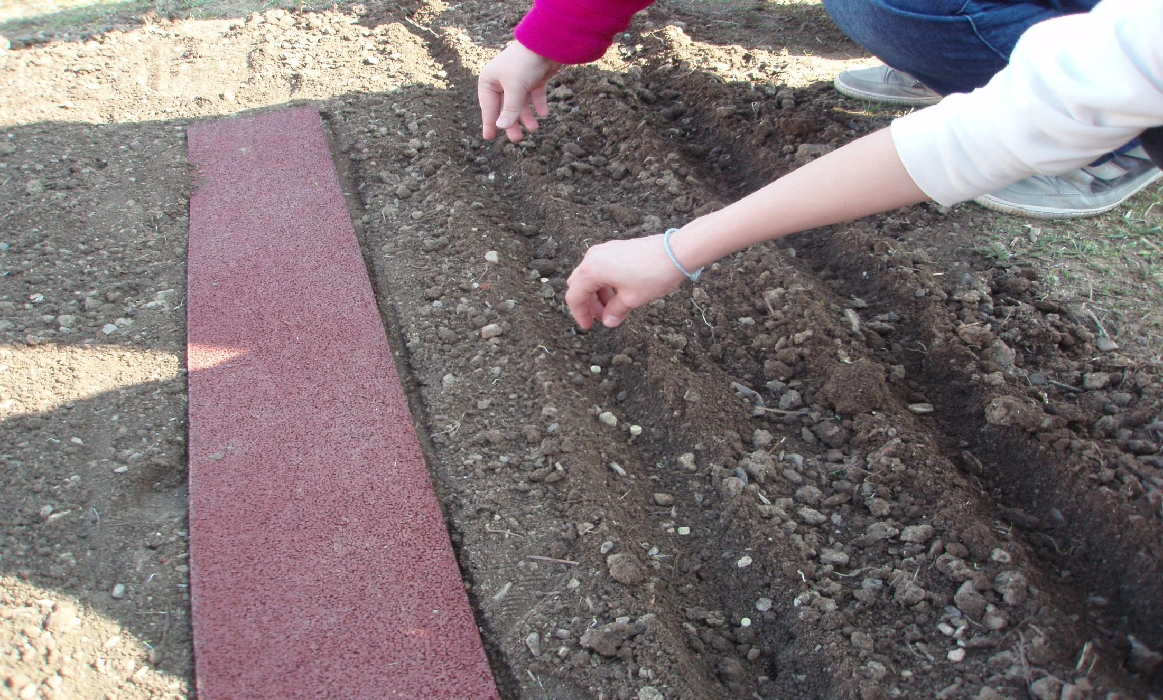
Our seeds – be happy!

Slide 8
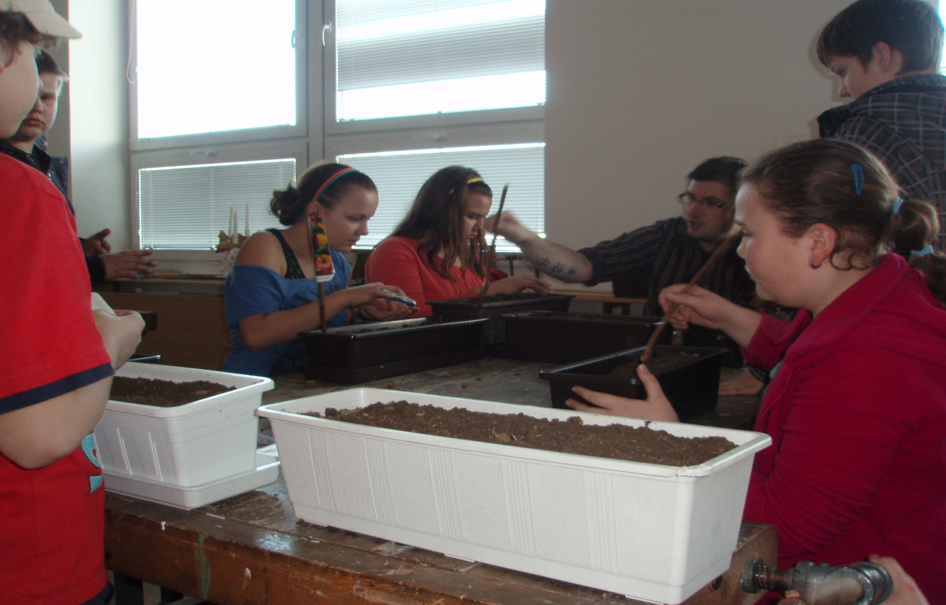
We want to have more and more flowers

Slide 9
Quite nice sunflower

Slide 10
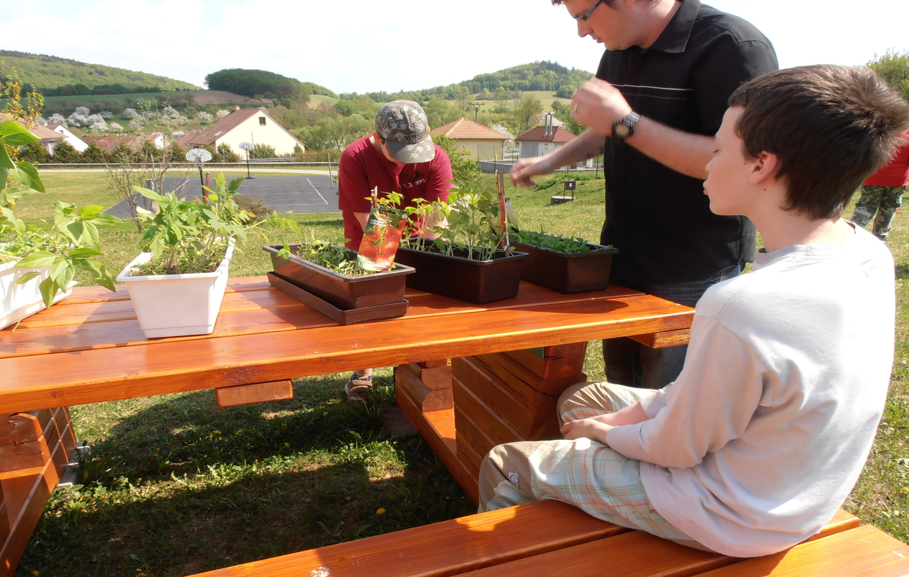
What´s this?

Slide 11
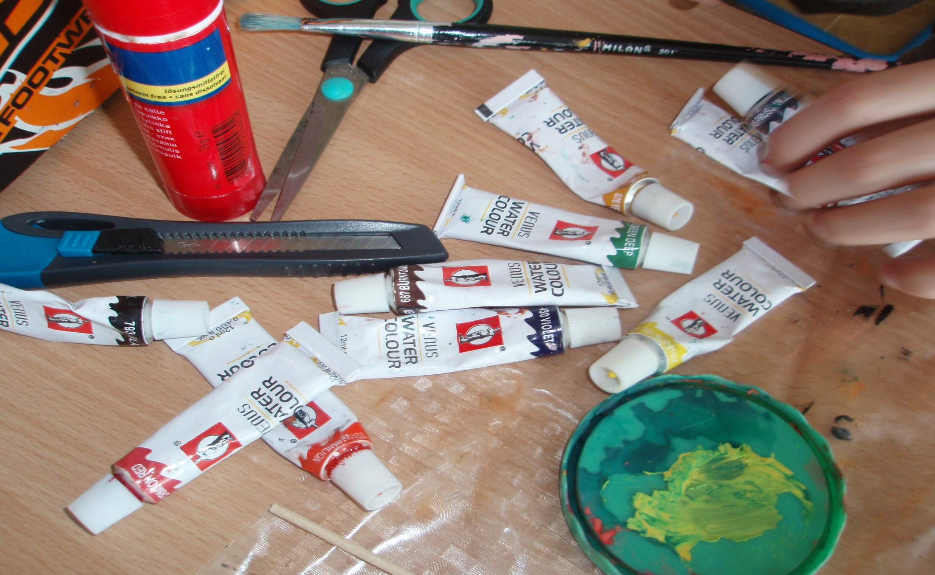
We will make things from plastic rubbish

Slide 12
Painting is funny

Slide 13
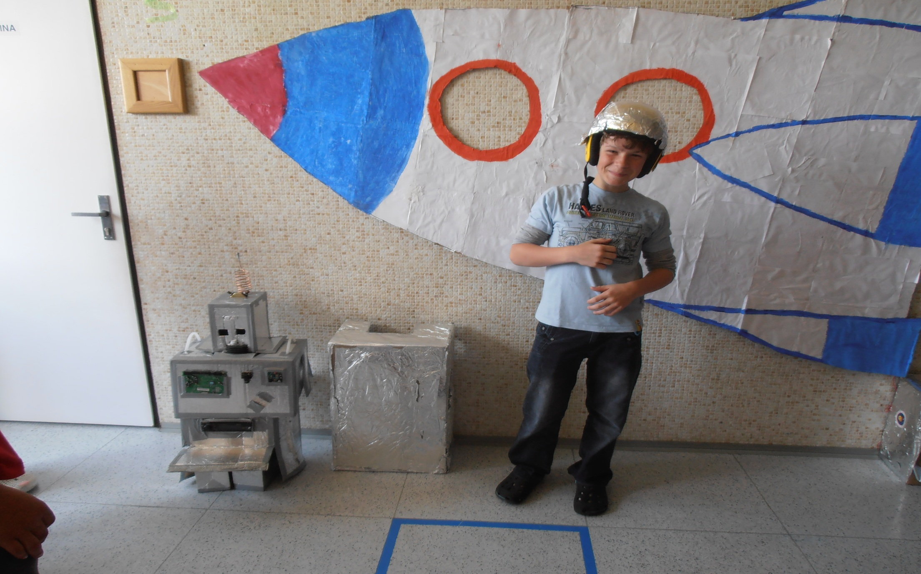
Playing with rubbish

Slide 14
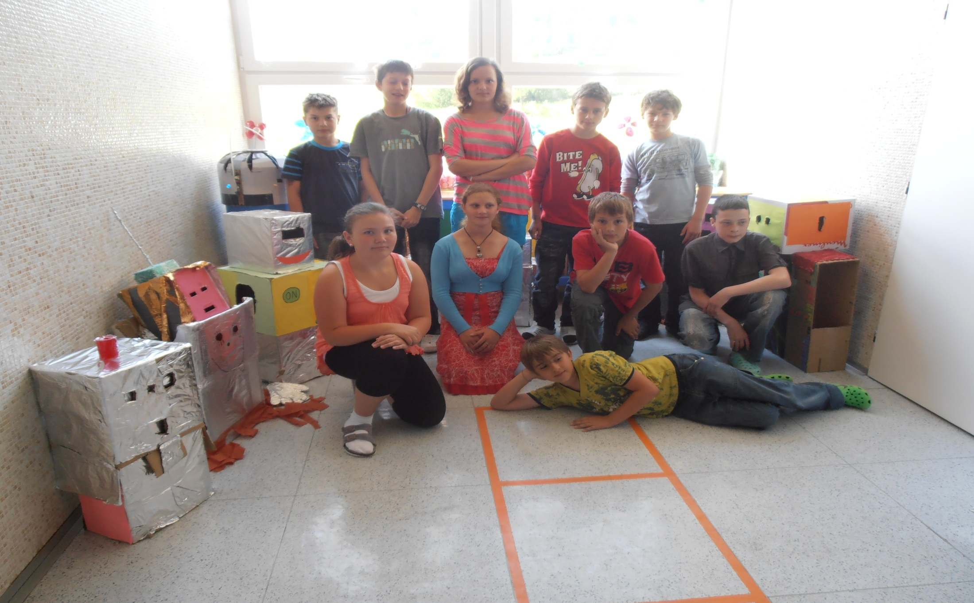
We are happy

Slide 15
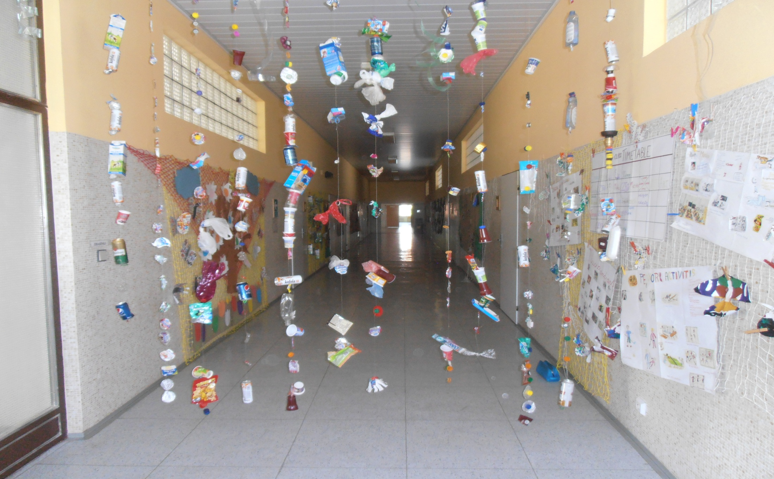
Oh, what a nice curtain

Slide 16
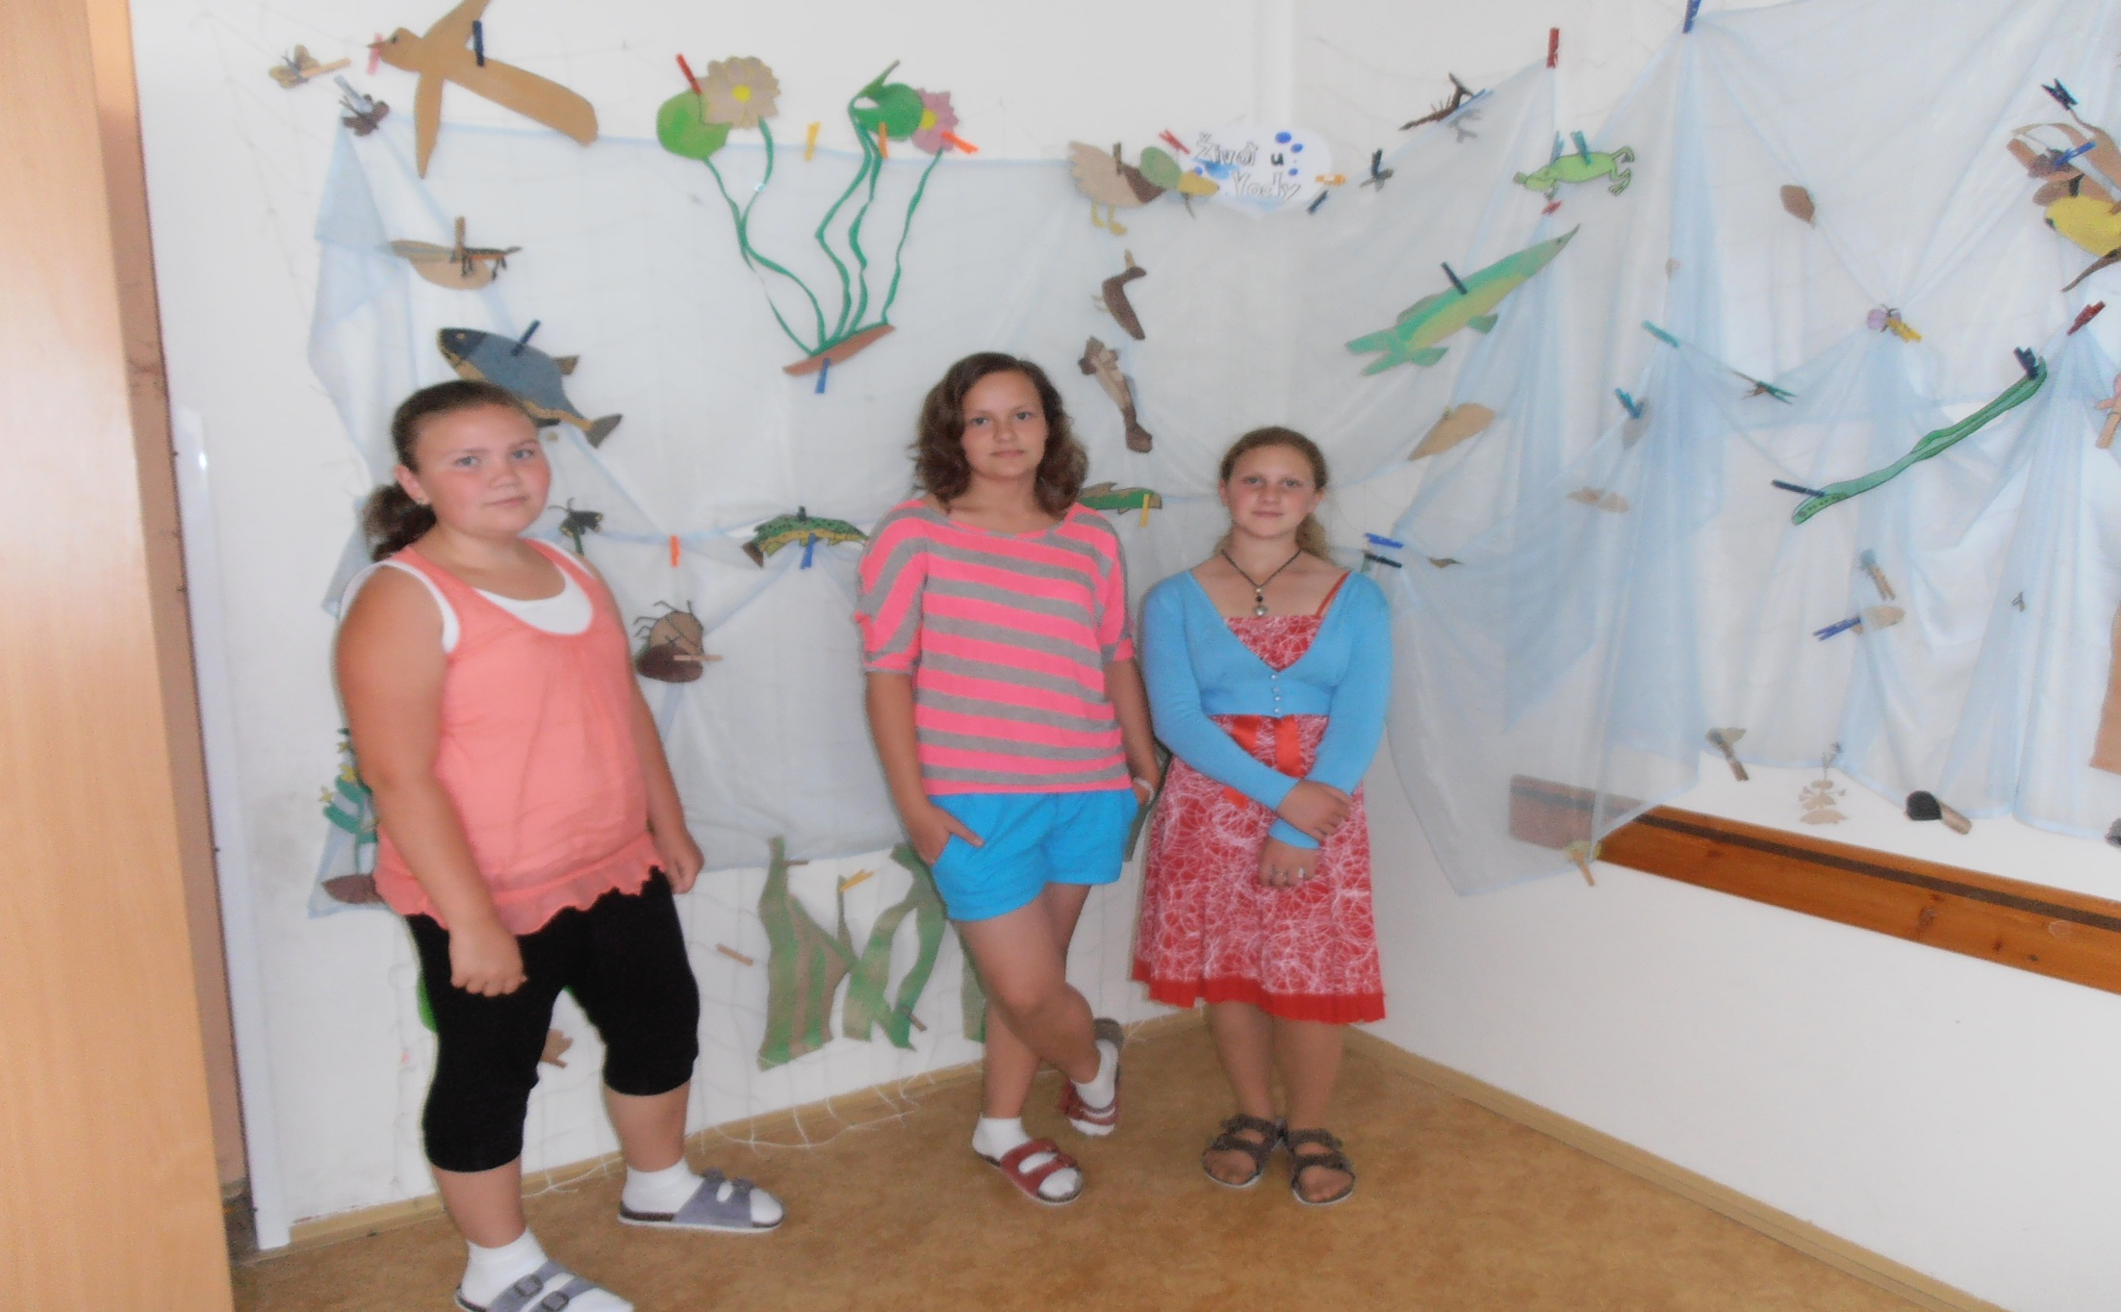
Our mermaids

Slide 17
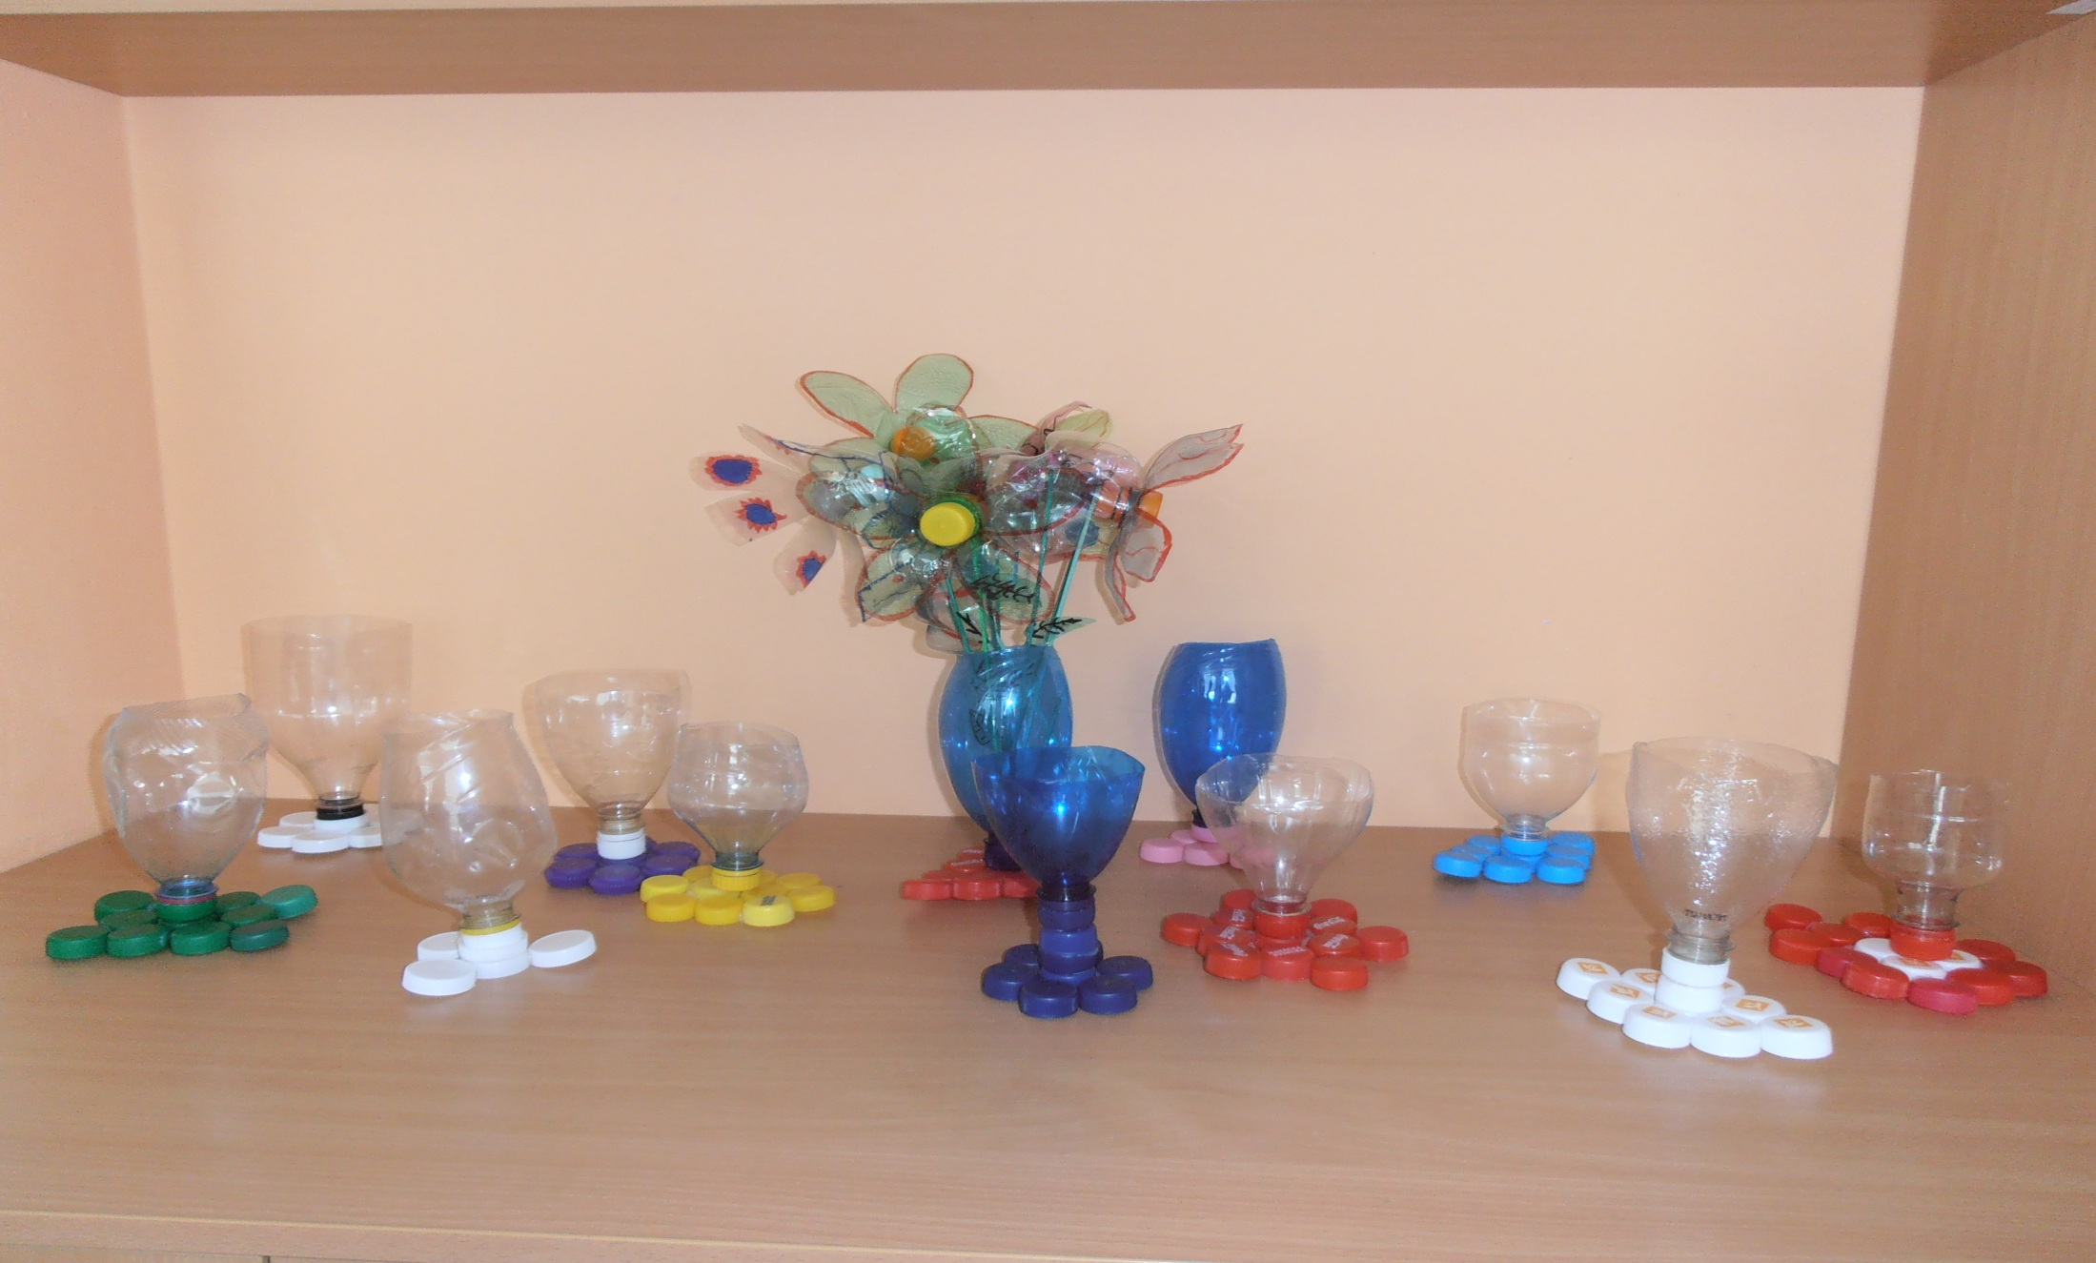
Our rubbish exhibition

Slide 18
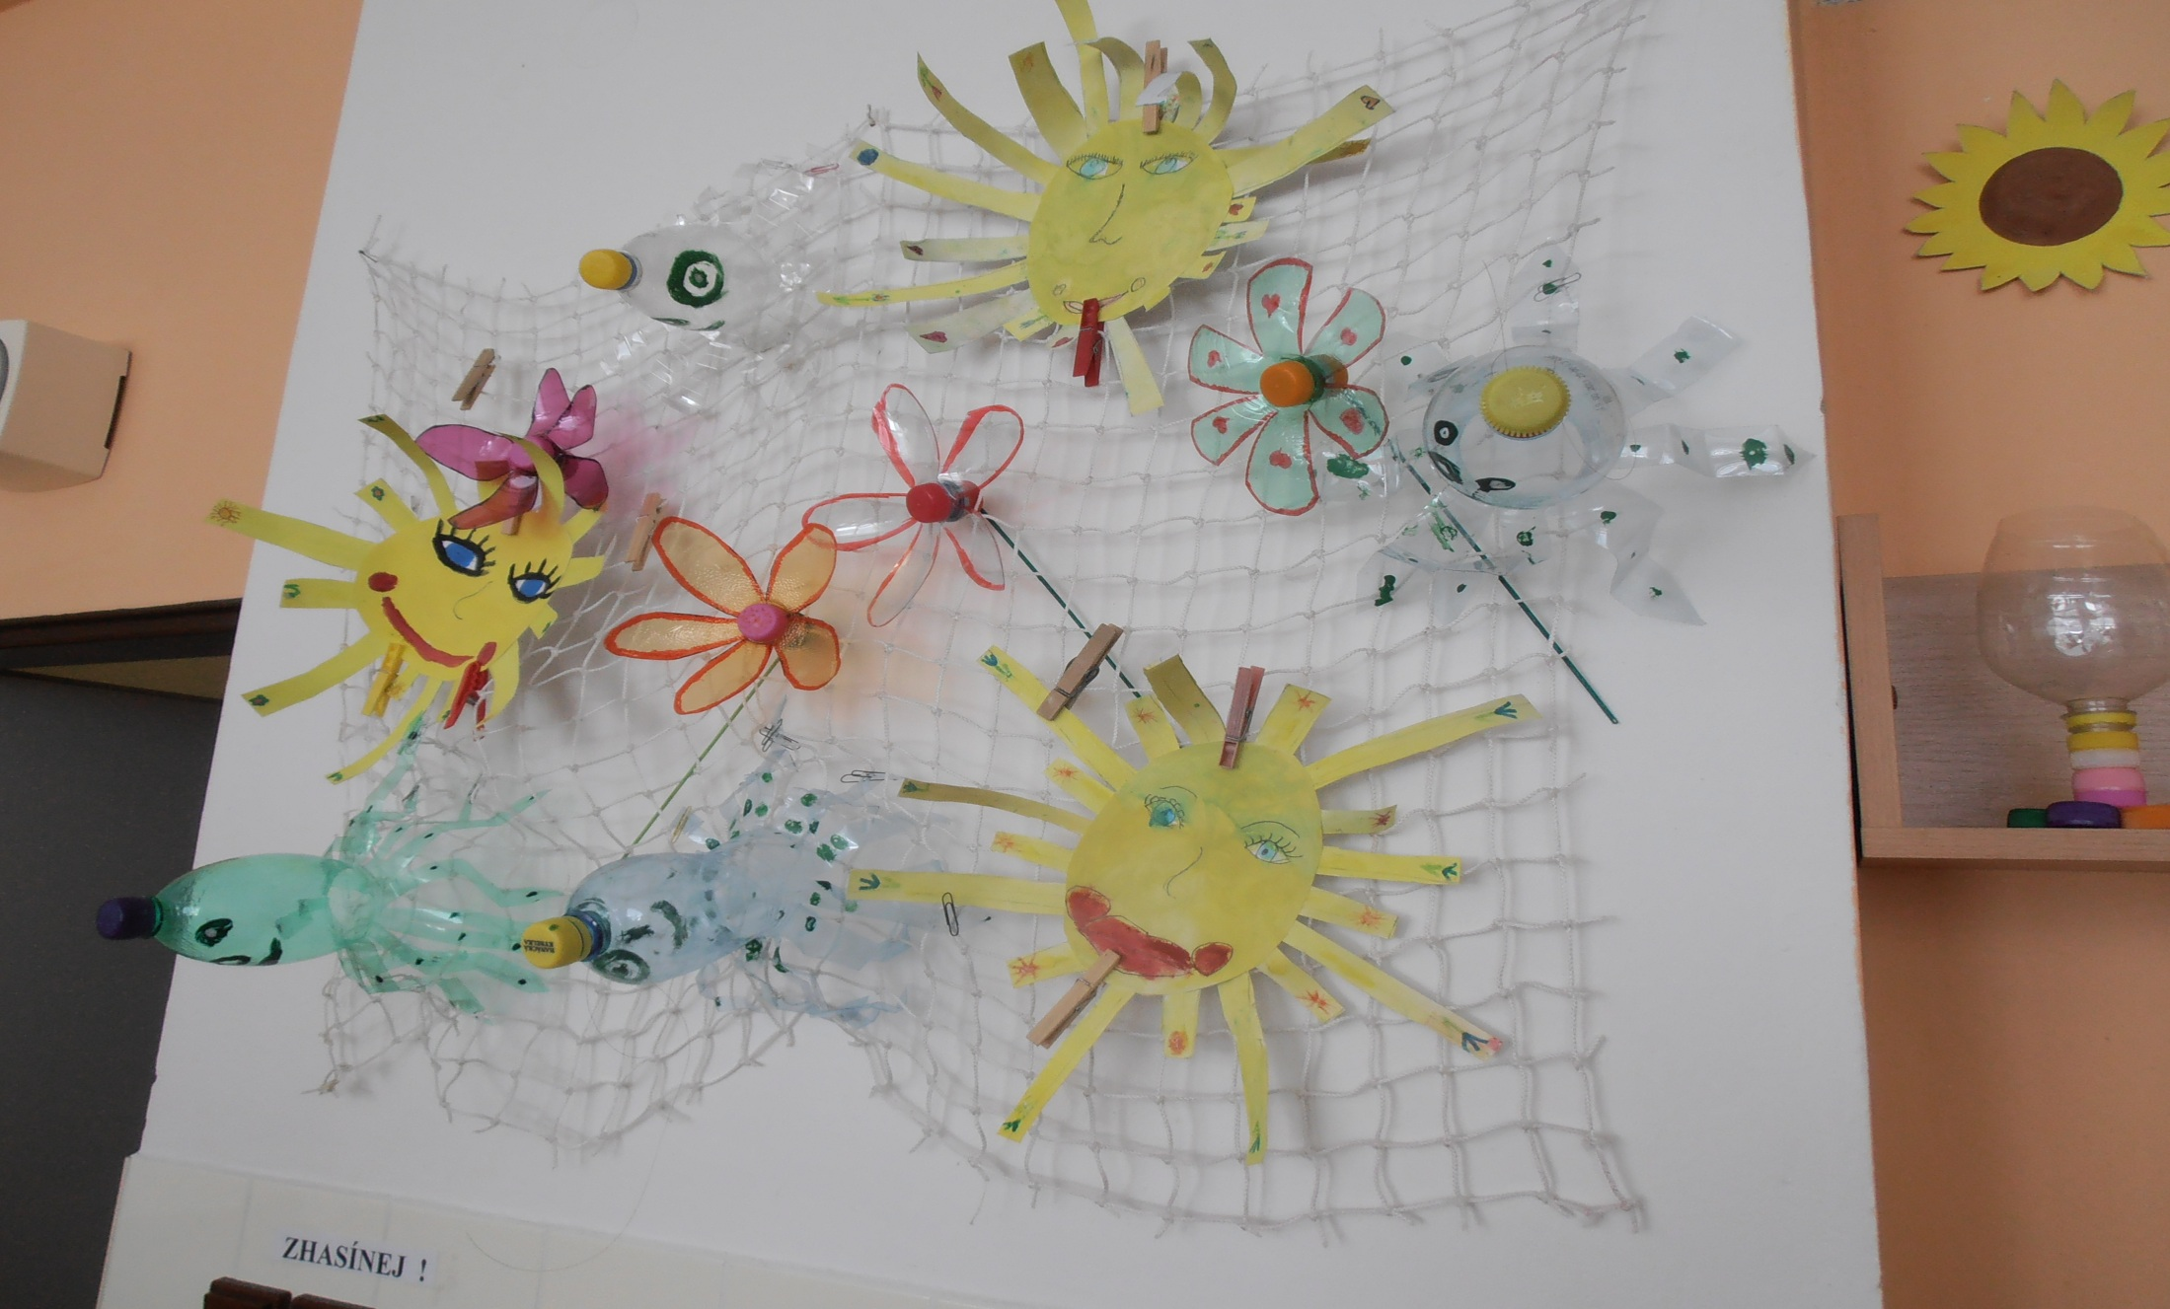
Our sunnies

Slide 19
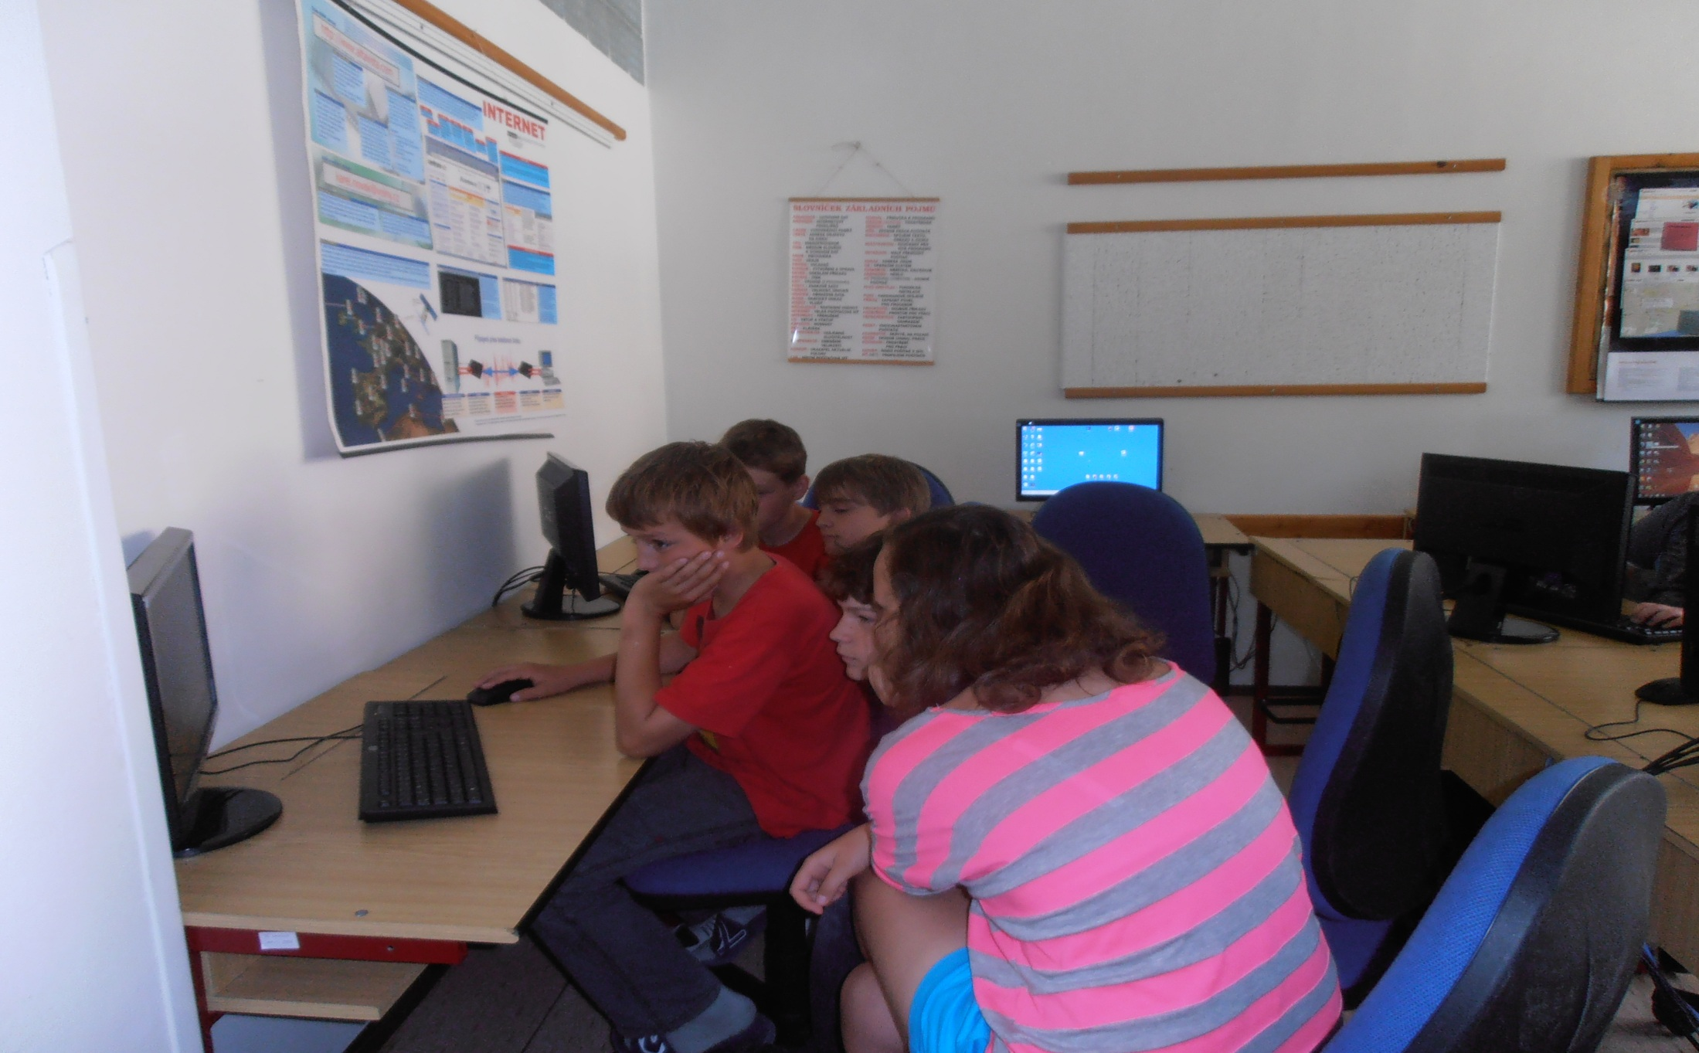
Our hard working team – Bye!

